Slide 1
Lecture 1: Welcome to CS88!

Slide 2
Useful Links
https://c88c.org
https://go.c88c.org/qa1

Slide 3
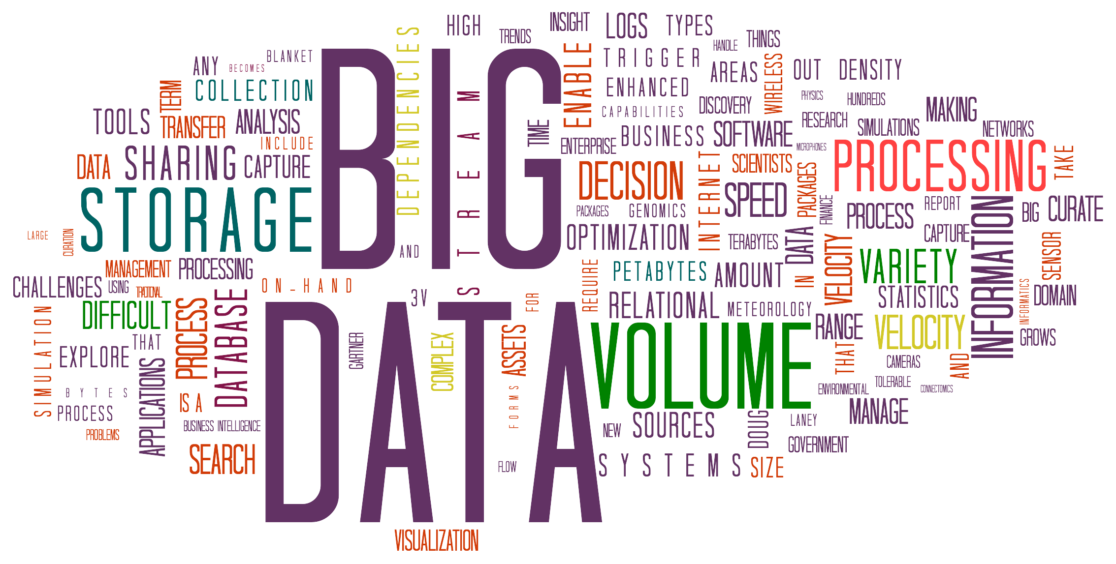

Goals today
Introduce you to
the field
the course
the team
Answer your questions
Big Ideas:
Abstraction
Data Type
Notes:
Questions:
- Freshman/Soph vs Jr/Sen
- New to programming vs experienced
- CS10
- CS61A
- Might want to major? Minor? Just do some CS?
- Love c8 so far?

Slide 4
CS88 Team –Michael
Michael Ball
ball@Berkeley.edu – You’re best off by using Ed! ☺
784 Soda Hall
http://michaelball.co – I don’t update this much…
It was great procrastination when I was a CS student.
Office hours: tentatively Monday afternoon. "coffee chat"
My office hours should be conceptual, higher level advice. ☺
Things I do:
Intro CS Research (Tools, curriculum)
Training TAs
Building Educational Software (Snap!, frmr Gradescope)
Tools for web accessibility

Slide 5
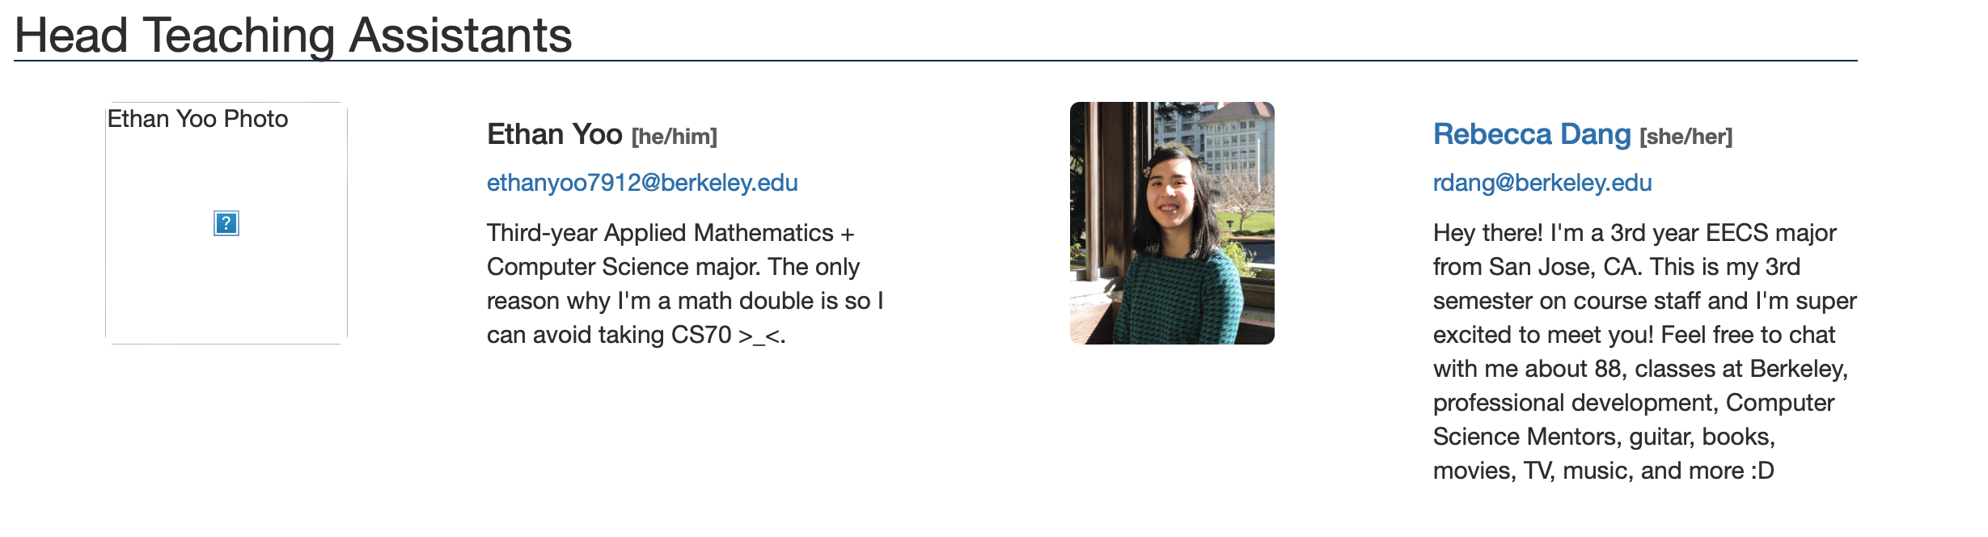
CS88 Team – Head TAs : cs88@berkeley.edu

Slide 6
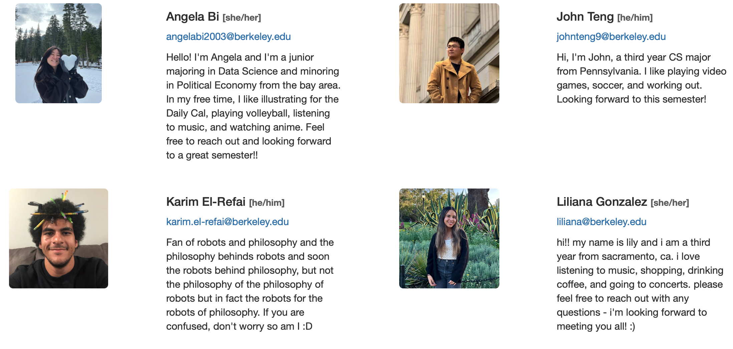
CS88 Team -- TAs

Slide 7
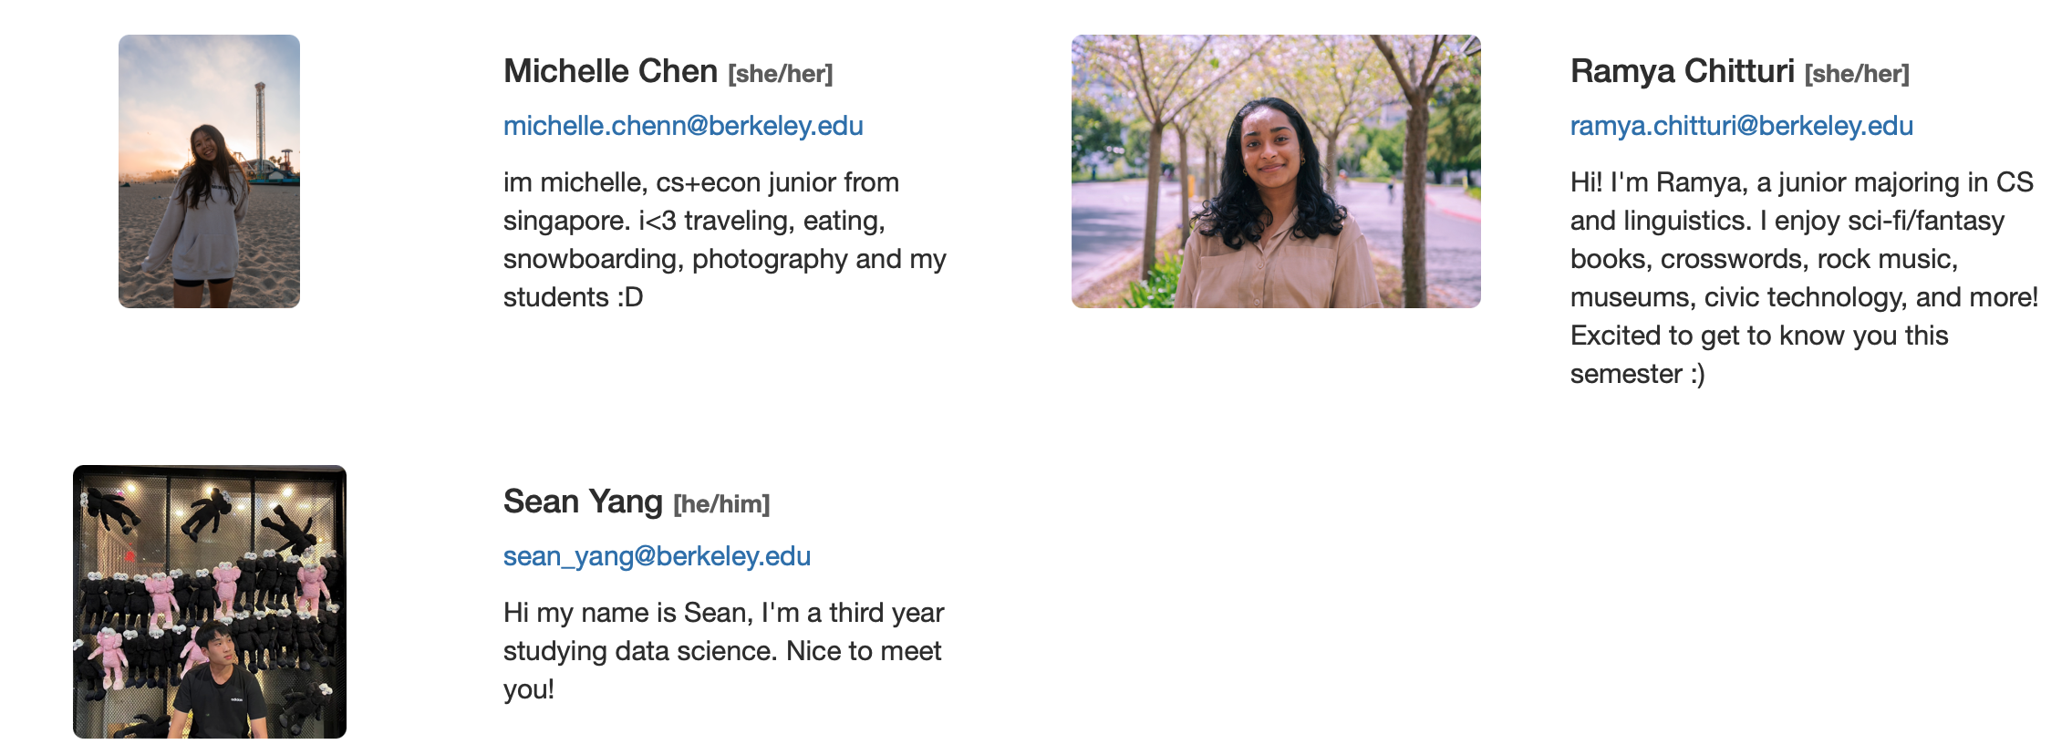
CS88 Team -- TAs

Slide 8
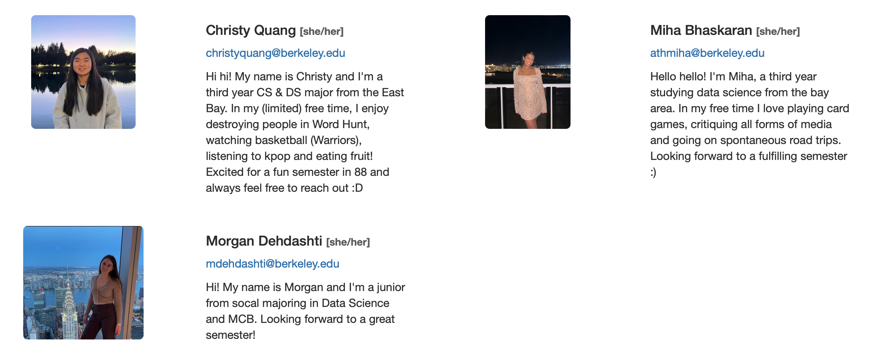
CS88 Team -- Tutors

Slide 9
In The News
AI-Driven Misinformation 'Biggest Short-Term Threat to Global Economy'
The World Economic Forum's annual risks report, based on a survey of 1,300 experts, revealed that respondents believe the biggest short-term threat to the global economy will come from AI-driven misinformation and disinformation. This is a major concern, given that elections will be held this year in countries accounting for 60% of global gross domestic product. Other short-term risks cited by respondents include extreme weather events, societal polarization, cyber insecurity, and interstate armed conflict.
The Guardian; Larry Elliott (January 10, 2024)

Slide 10
Computer Science and Data Science

Slide 11
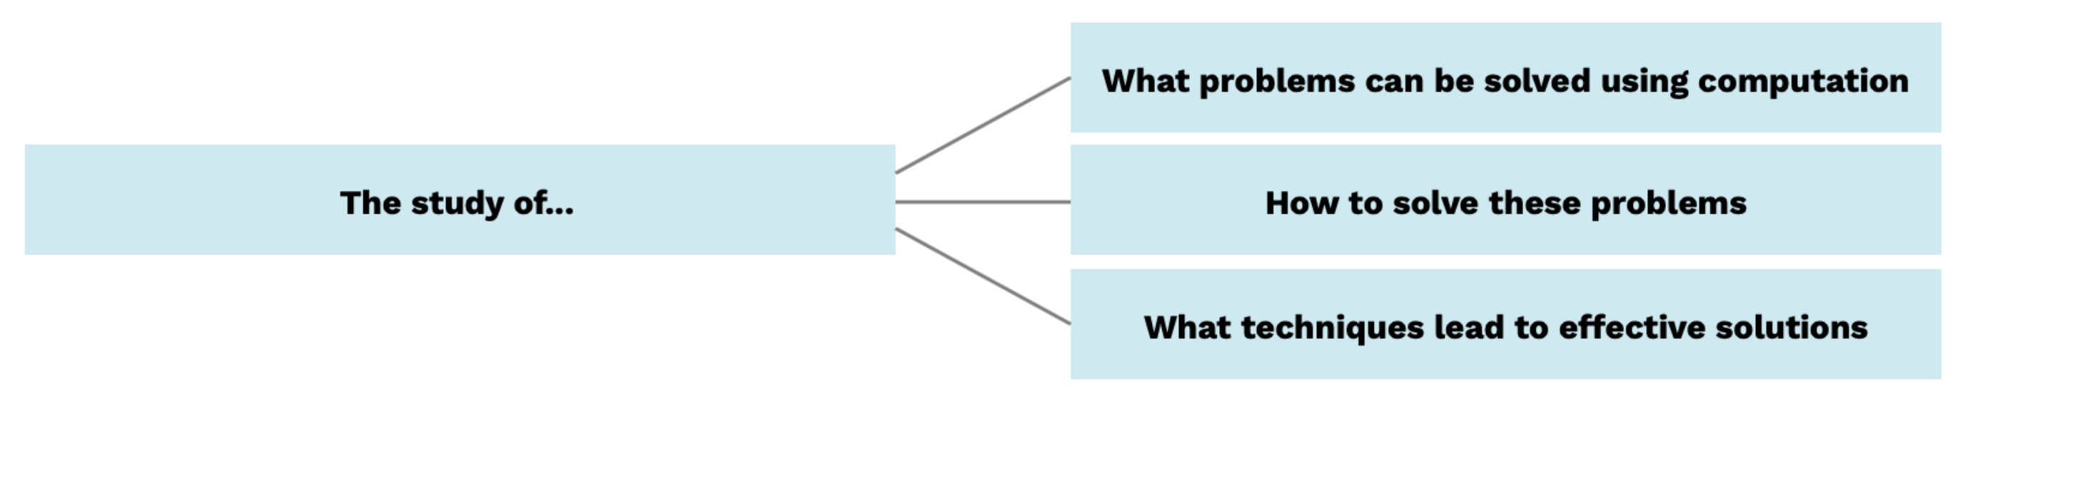
Computer Science

Slide 12
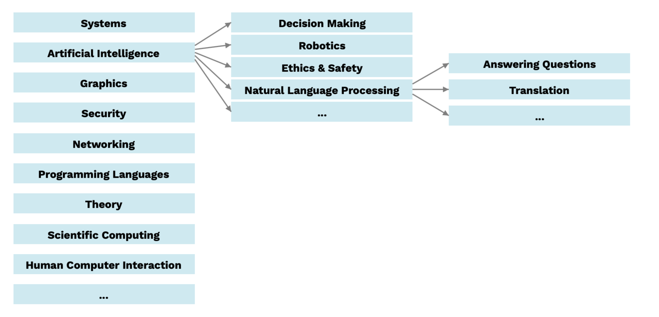
Computer Science, Some Ideas…Definitely Not Exhaustive!

Slide 13
Computer Science & Data Science (One View)
Computer Science
CS88
Sociology, Psychology, Biology, Ethics, History, Econ
Statistics, Math
Data Science

Slide 14
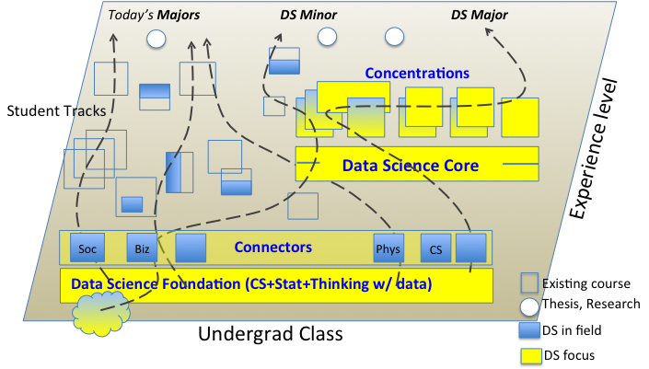
Data 8 – Foundations of Data Science
Computational Thinking + Inferential Thinking in the context of working with real world data
Introduce you to several computational concepts in a simple data-centered setting
Authoring computational documents
Tables
A LOT of statistics

Slide 15
CS88 – Computational Structures in Data Science
Deeper understanding of the computing concepts introduced in DATA8
Hands-on experience => Foundational Concept
How would you create what you use in DATA 8?
Extend your understanding of the structure of computation
What is involved in interpreting the code you write?
Deeper CS Concepts: Recursion, Objects, Classes, Higher-order Functions, Declarative programming, …
Managing complexity in creating larger software systems through composition
Create complete (and fun) applications
In a data-centric approach

Slide 16
How does C88C relate to CS61A?
Interpretation
(Scheme Proj)
Thinking w/ Data
Working w/ Data
CS Concepts
and
Techniques
Statistics Concepts in a Computational Approach
CS Concepts
and
Techniques
Units
Intro Programming
Intro Programming
& Tools
Intro Programming
& Tools
CS61A
DATA8
DS/CS C88C
Notes:
Cascade
C8
C8 + CS 88
C8 + CS88 + CS61B
CS minor
CS Major

Slide 17
Opportunities for students
DATA 8 | DS C88C
DS Minor
DATA 8 | DS C88C | CS61B
CS minor & DS Major
DATA 8 | CS88 | CS47A
CS major:
CS47A path is not recommended, but there if you change your mind.
CS61A

Slide 18
The Data Science Major
Computational & Inferential Depth
Modeling, Learning & Decision Making
Human Contexts & Ethics
Domain Emphasis
Individualized Upper Division
30 units
Probability
Data 100: Principles & Techniques of Data Science
Electives
Mathematics
Computing
Domain Emphasis
Foundational Lower Division
College Breadth & Electives
Data 8: Foundations of Data Science

Slide 19
Success In C88C

Slide 20
Course Culture
Learning
Community
Collaboration
Peer Instruction
Respect
A supportive course staff & environment
Lots of outside community, CS Mentors, HKN, others.

Slide 21
Collaboration
Asking questions, discussing topics, helping each other is always encouraged!
When you're working with a partner, you are expected to share in the work.
Collaboration has limits
Please don't read someone else's code
except if you have already turned in the assignment, or a TA/staff member is present.
You can help others, but not give the solutions.
We have a very particular set of skills and we will use them.

Slide 22
So…We Know About ChatGPT
You may use ChatGPT (and other tools) like a tutor
You may not ask about specific questions assigned to you!
Remember: It’s a bot.
Bots are fallible!
Check its advice.
Good Example:
“When would I prefer a for-loop over a while loop in Python?”
“What is a higher order function?”
Bad Example:
“Provide a solution to the Fibonacci sequence using recursion”

Slide 23
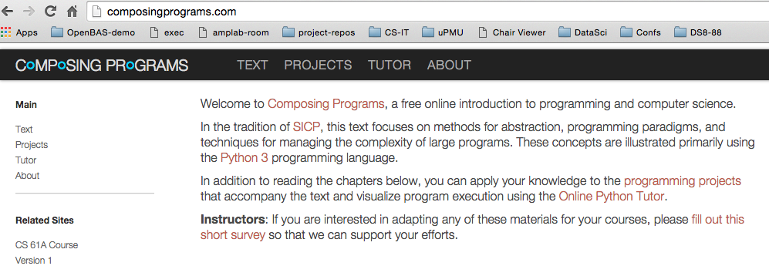
Course Structure
2 lectures, 1 lab each week
Lecture introduces concepts (quickly!), answers why questions.
Lab provides concrete detail hands-on
Homework (11) cements your understanding
Projects (2) put your understanding to work in building complete applications
Maps
Ants vs Some Bees
Readings: http://composingprograms.com
Same as cs61a
Notes:
Course Policies:
- Learning: The purpose of this course is to learn something you don't
already know.
You should never feel bad for not understanding something yet.
I won't tolerate disrespectful or condescending comments.
If someone doesn't understand something, help them out.
- Community: You're encouraged to help each other;
One of the most important things you can learn in college is how to explain
- Course Staff: We are here to help you succeed, not to judge you.
We know that you're talented b/c you're at Berkeley
We know that you're able to work hard, and we're here to make
sure that working hard leads to the results you want.

Slide 24
Class Format
Mon and Weds Lectures:
Each lecture has a series of short self-check questions
Lectures go quickly
Labs are paced throughout the week. See the Ed post to pick a time.
Labs are HANDS ON – Get help as you're trying the lab.
Labs are active
Find and make friends!
Do not ask for more lectures
Ask why something doesn’t make sense.

Slide 25
Class Format: Assignments
Lecture Quizzes, 1 point, max 20.
1 per lecture, “due” in ~4 days. (Partial credit after)
https://go.c88c.org/1
Lab Work: 4 points, 11 labs, 1 drop
Start them during lab! You can probably finish some labs in 2 hours. Will be Python + some interactive questions.
Homework: 8 points, 11 HW, 1 drop
Start early!
Projects: 100 points between 2 projects
Start early! ”Checkpoint” assignments

Slide 26
Lab Attendance & Credit
Labs are graded on correctness
If you attend, you get 2/4 points
You get the other 2/4 points by solving questions
Most labs will have 2-5 questions.
If you can't attend, you solve all the lab questions.
There are no "make ups" or excused absences.
Solving half the questions shouldn't take 2 hours in most cases.
If folks abuse the attendance system, we'll change it.

Slide 27
Extensions & Extenuating Circumstances
https://go.c88c.org/extensions
Contact us early!!
Our goal is to have you do the work, but we can't manage things at 11:50PM
If you need <= 3 days, do not submit the form.
If you know you will be travelling, etc. Let us know ASAP.

Slide 28
Class Format: Assignments
Slip Days: 9 total
Use up to 3 on any assignment
We apply the in the order that’s most beneficial!
i.e. use them on projects if you need!
Can be used for homework, labs, projects, but not project checkpoints.
Slip Days take care of almost all special circumstances!
We will release an exceptions / extensions request form.
What if you go over slip days?
25% deduction for each day over. Mathematically you can still earn 25% if you turn in something 3 days late.

Slide 29
Class Format: Exams
1 midterm and 1 final exam, in person
Remote exams proctored via Zoom
Required verification for alternate exams.
Midterm 2 hours, early October
Exam will be during the slot assigned by campus.
5 handwritten cheat sheets double-sided.
You don’t actually need 5 sheets!

Slide 30
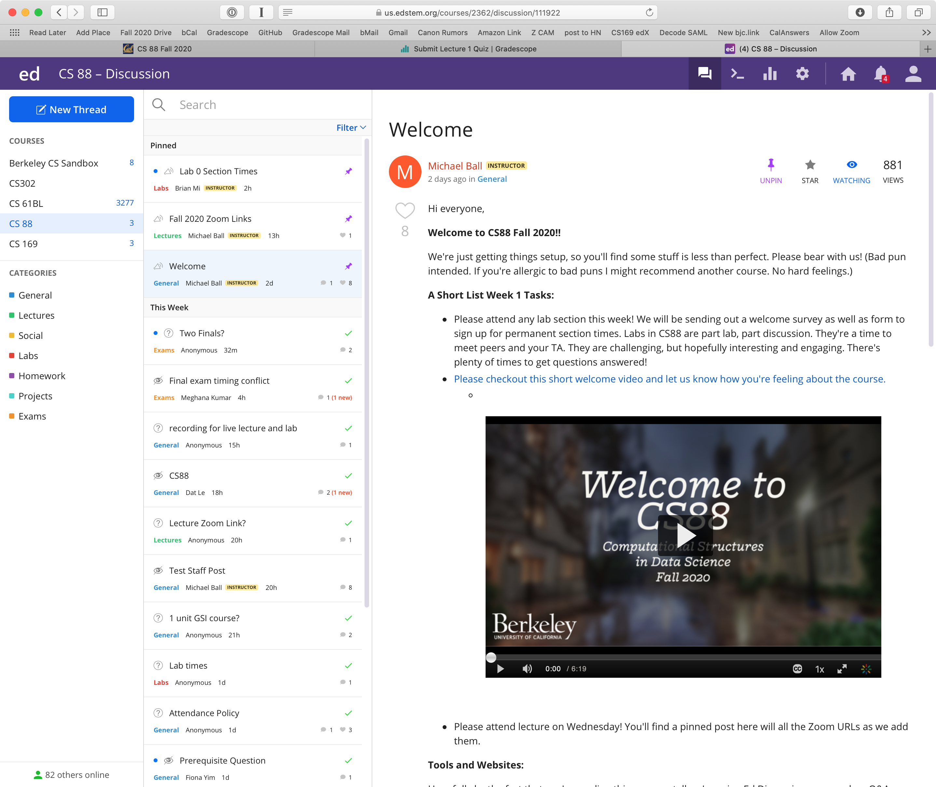
Ed For Class Discussion: Try it!

Slide 31
Where will we work?
Your laptop
Using an editor and a terminal
okpy – okpy.org
c88c.org
gradescope.com – HW, Lab, Lecture Self-Checks
Ed Discssion: edstem.org
Can write and run (!!) python in you own posts!

Slide 32
Poll: Check In
How has lab gone so far?
A. Labs have gone fantastic!
B. Labs have gone alright…
C. Labs have gone very well…
D. I haven’t been to lab yet.
Notes:
Questions:
- Freshman/Soph vs Jr/Sen
- New to programming vs experienced
- CS10
- CS61A
- Might want to major? Minor? Just do some CS?
- Love c8 so far?

Slide 33
Demo?

Slide 34
Take Things 1 Step at a Time
We interact with Python via the Terminal
We type programs into files and into other programs.
Everything you do in this class is safe!
Try and experiment!

Slide 35
Your Tasks
Lecture 1 "self-check" on Gradescope
Attend Lab 0
Attend OH
Welcome, and Good luck!

Slide 36
Questions?

Slide 37
Abstraction

Slide 38

Abstraction
Detail removal
“The act of leaving out of consideration one or more properties of a complex object so as to attend to others.”
Generalization
“The process of formulating general concepts by abstracting common properties of instances”
Technical terms: Compression, Quantization, Clustering, Unsupervized Learning
Henri Matisse “Naked Blue IV”

Slide 39
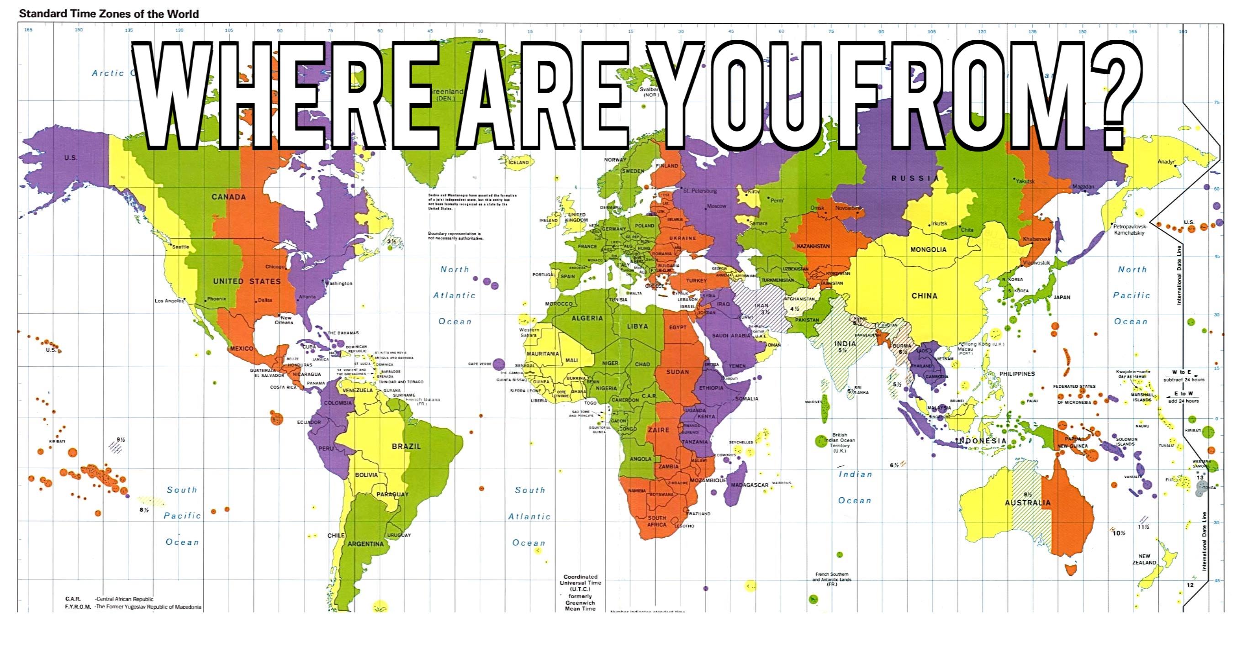
Experiment

Slide 40

Where are you from?
Possible Answers:
Planet Earth
Europe
California
The Bay Area
San Mateo
1947 Center Street, Berkeley, CA
37.8693° N, 122.2696° W
All correct but different levels of abstraction!

Slide 41
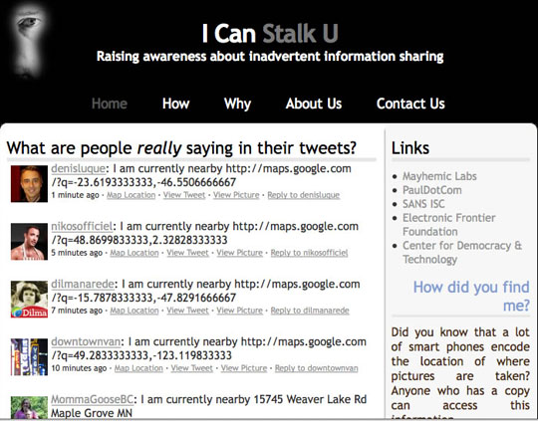
Abstraction gone wrong!

Slide 42
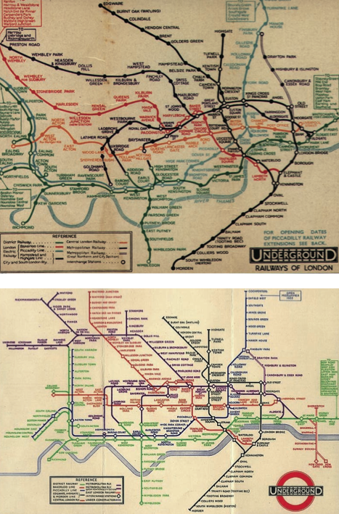
Detail Removal (in Data Science)
You’ll want to look at only the interesting data, leave out the details, zoom in/out…
Abstraction is the idea that you focus on the essence, the cleanest way to map the messy real world to one you can build
Experts are often brought in to know what to remove and what to keep!
The London Underground 1928 Map & the 1933 map by Harry Beck.

Slide 43
The Power of Abstraction, Everywhere!
Examples:
Functions (e.g., sin x)
Hiring contractors
Application Programming Interfaces (APIs)
Technology (e.g., cars)
Amazing things are built when these layer
And the abstraction layers are getting deeper by the day!
We only need to worry about the interface, or specification, or contract
NOT how (or by whom) it’s built
Above the abstraction line
Abstraction Barrier (Interface) (the interface, or specification, or contract)
Below the abstraction line
This is where / how / when / by whom it is actually built, which is done according to the interface, specification, or contract.

Slide 44
Abstraction: Pitfalls
Abstraction is not universal without loss of information (mathematically provable). This means, in the end, the complexity can only be “moved around”
Abstraction makes us forget how things actually work and can therefore hide bias. Example: AI and hiring decisions.
Abstraction makes things special and that creates dependencies. Dependencies grow longer and longer over time and can become unmanageable.

Slide 45

Algorithm
An algorithm (pronounced AL-go-rith-um) is a procedure or formula to solve a problem.
An algorithm is a sequence of instructions to change the state of a system. For example: A computer’s memory, your brain (math), or the ingredients to prepare food (cooking recipe). Think Data 8: Change or retrieve the content of a table.

Slide 46
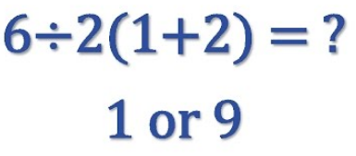
Algorithm: Properties
An algorithm is a description that can be expressed within a finite amount of space and time.
Executing the algorithm may take infinite space and/or time, e.g. ``calculate all prime numbers”.
In CS and math, we prefer to use well-defined formal languages for defining an algorithm.

Slide 47
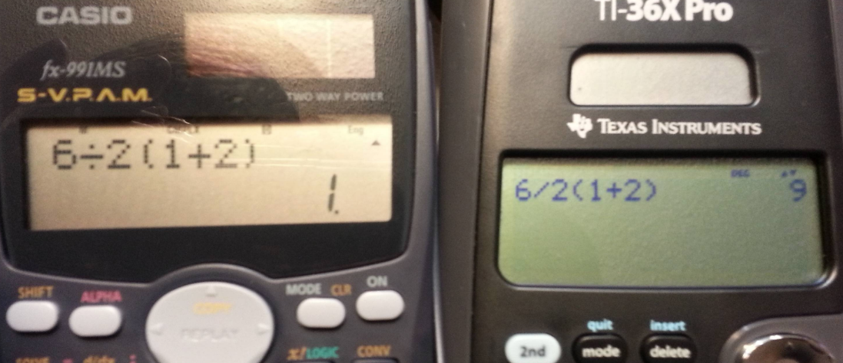
Algorithm: Well-Definition

Slide 48
Algorithms Early In Life (1st Grade)
1
carry (MSD)
7
operands
operator
+
8
5
least significant digit of result

Slide 49
Algorithms Early In Life (In Binary)
1
1
0
0
carry (MSD)
1
1
1
0
14
operands
1
1
0
0
+
12
operator
+
1
1
0
1
0
26
LSB result

Slide 50
More Terminology (Intuitive)
Code
A sequence of symbols used for communication between systems (brains, computers, brain-to-computer)
Data
Observations
Information
Reduction of uncertainty in a model (measured in bits)

Slide 51
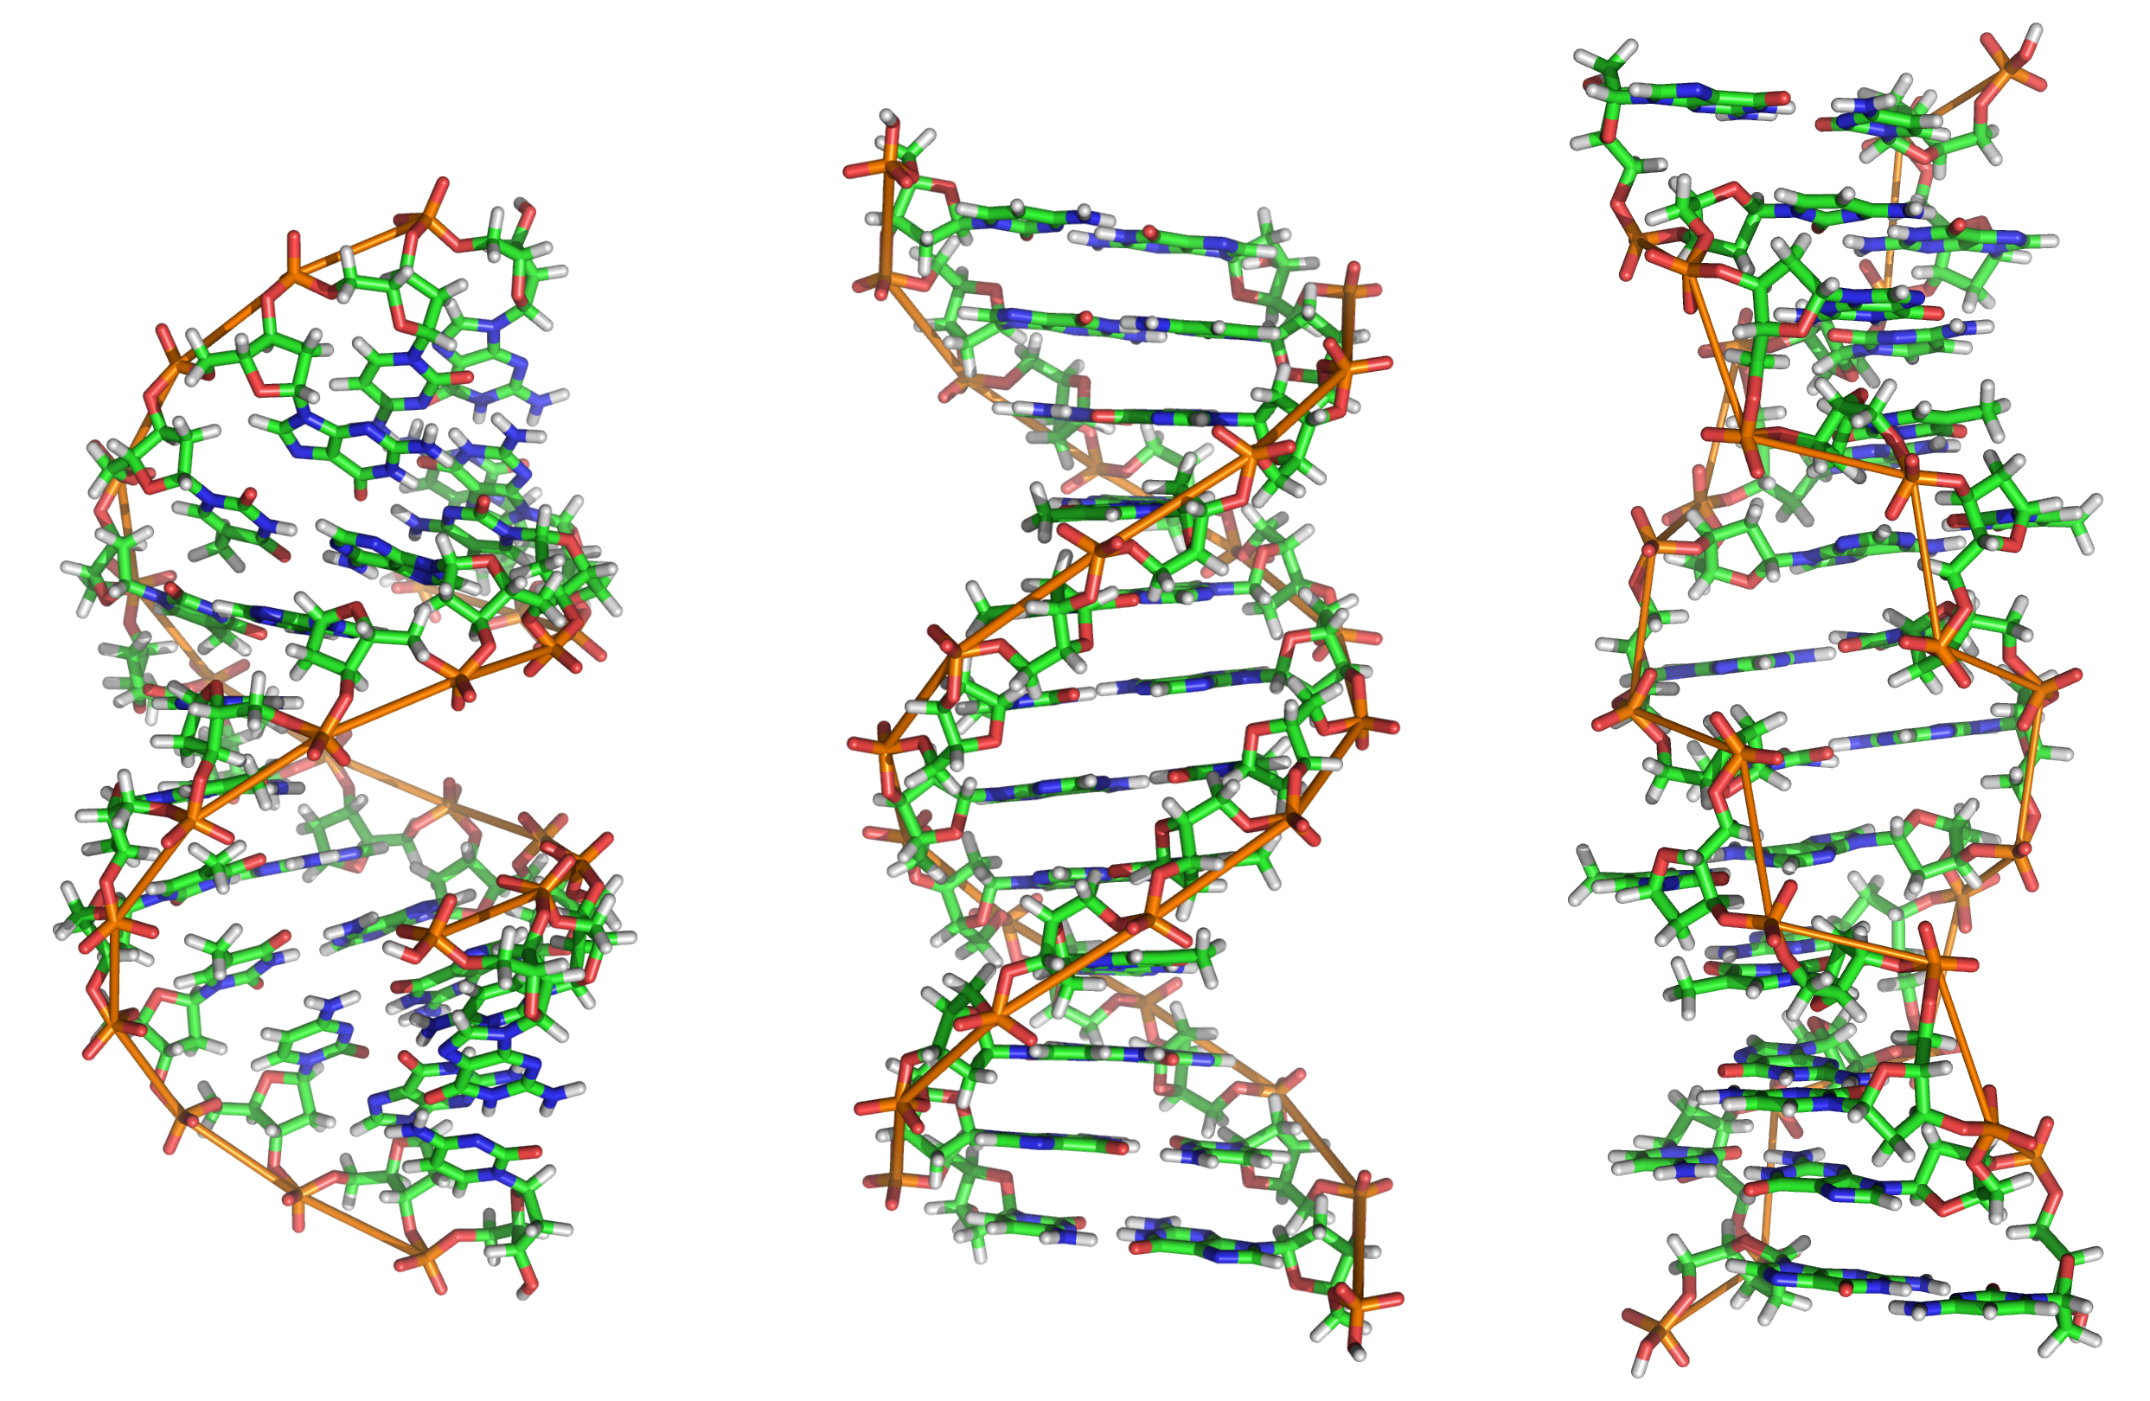
Data or Code?

Slide 52
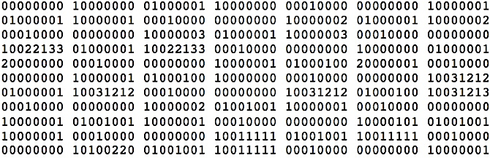
Data or Code?

Slide 53
Data or Code?
Here is some information!
Integer
Instruction
String

Slide 54
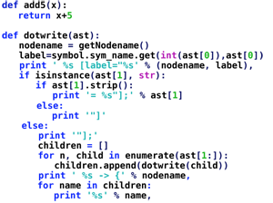
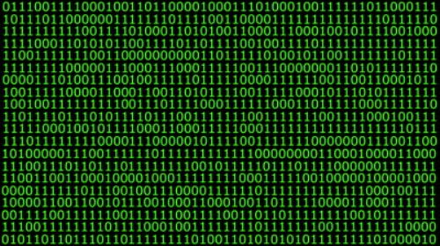
Data or Code? Abstraction!
Human-readable code (programming language)
Machine-executable instructions (byte code)
Compiler or Interpreter
Here: Python

Slide 55
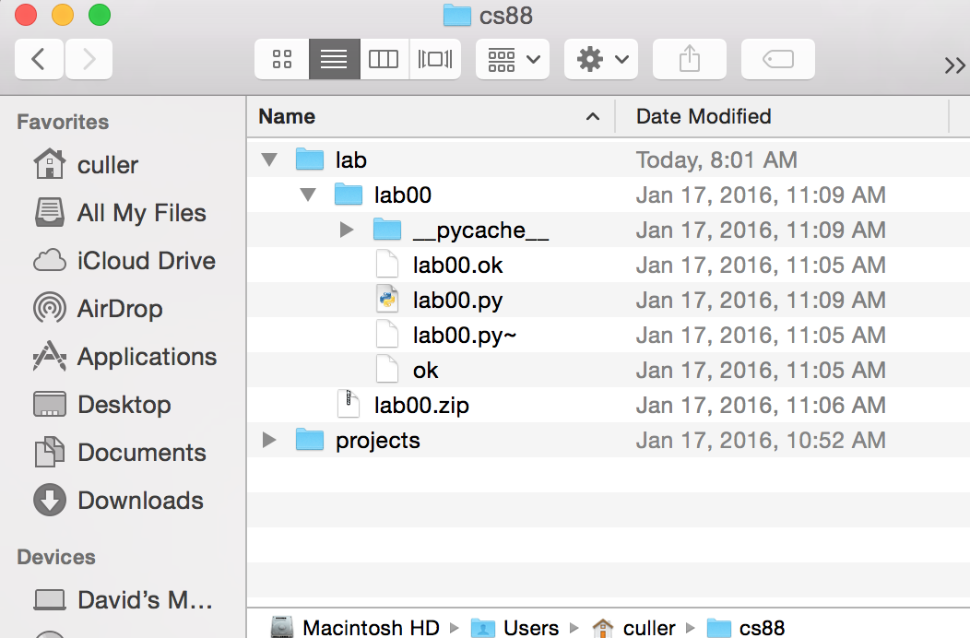
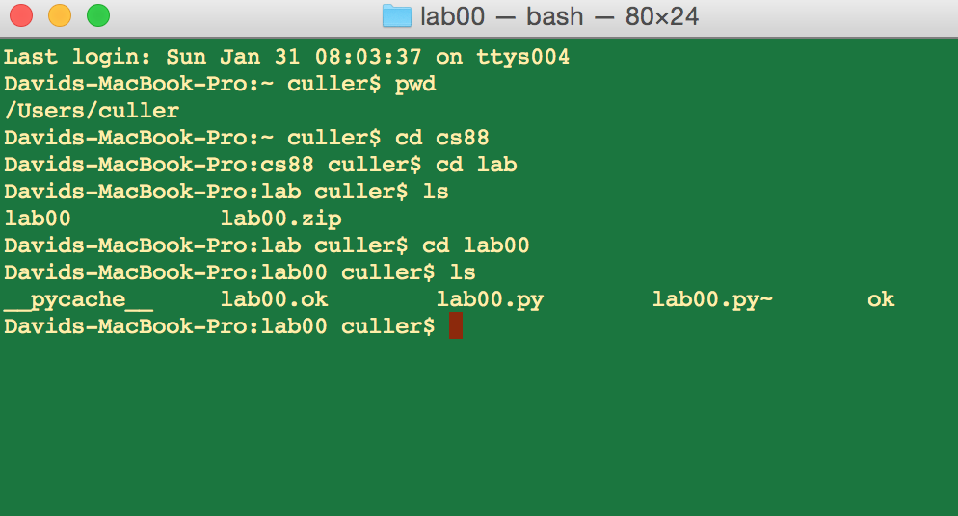
Code or GUI: More Abstraction!
Big Idea: Layers of Abstraction
The GUI look and feel is built out of files, directories, system code, etc.

Slide 56
Review:
Abstraction:
Detail Removal or Generalizations
Code:
Is an abstraction!
Can be instructions or information
Computer Science is the study of abstraction

